Slide 1

SMART HEALTH Monitoring SYSTEM

Slide 2
Contents
Introduction
Existing system with Proposed system comparision
System Architecture
Sub-System Architecture
Work Completed
Conclusion
Cos & CO-PO Mapping
References

Slide 3
1.Introduction
Human health is one of the most important factor
Health care system more important in present situation like covid pandemic
Good Health Care System Is Needed
In rapid growth of technologies iot is best platform
Constantly Screen Patient’s Condition form Parameters Sensors
The diseases are diagnosed by the doctors from a far distance.
Patient information Stored in databse

Slide 4
2.Existing system with Proposed system
Existing System :-
The Health Monitoring System But not sufficient Because no proper
View of Data For the Doctor
issues in Power supply to Ardunio
Proposed System :-
We proposed a nonstop checking
the patient condition and store the patient information’s in server
Solar Power Used to SHMS

Slide 5
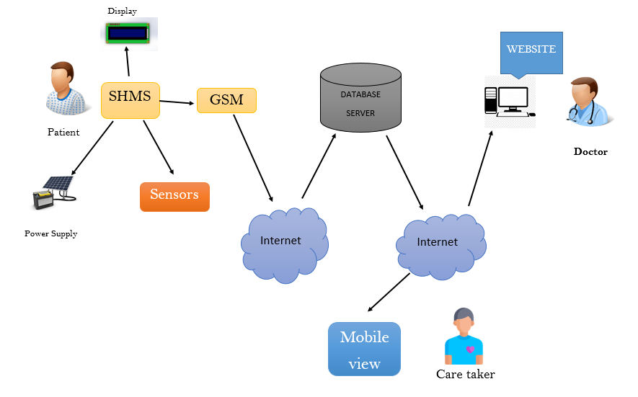
3.System Architecture

Slide 6
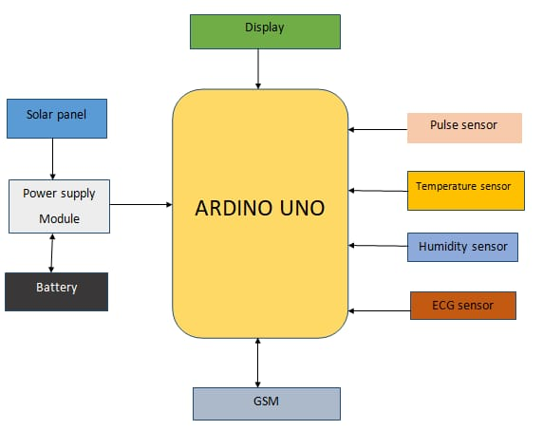
4.Sub-System Architecture

Slide 7
5.Work Completed
Sensors Part Completed

Slide 8
6.Conclusion
An efficient SHMS is developed to monitor the up to date status of the patient irrespective of the presence of the doctor.
The system collects information like temperature, blood pressure and pulse rate of the patient and updates the same to the doctor.
The system is evaluated experimentally and collected the sample data of ten patients to verify the status of patients.

Slide 9
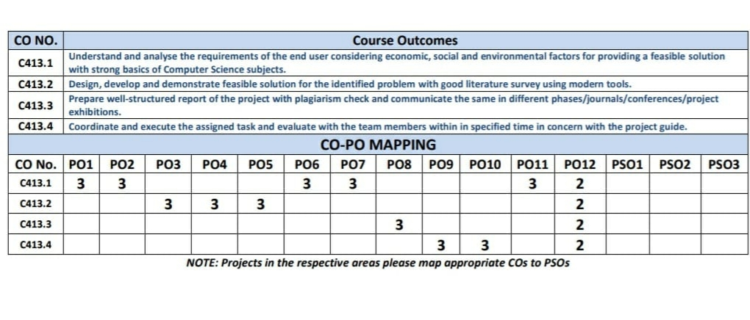
7.Cos & CO-PO Mapping

Slide 10
References
Rahaman A, Islam M, Islam M, Sadi M, Nooruddin S. Developing IoT based smart health monitoring systems: a review. Rev Intell Artif. 2019;33:435–40. https://doi.org/10.18280/ria.330605.
Lin T, Rivano H, Le Mouel F. A survey of smart parking solutions. IEEE Trans Intell Transp Syst. 2017;18:3229–53. https://doi.org/10.1109/TITS.2017.2685143

